Slide 1
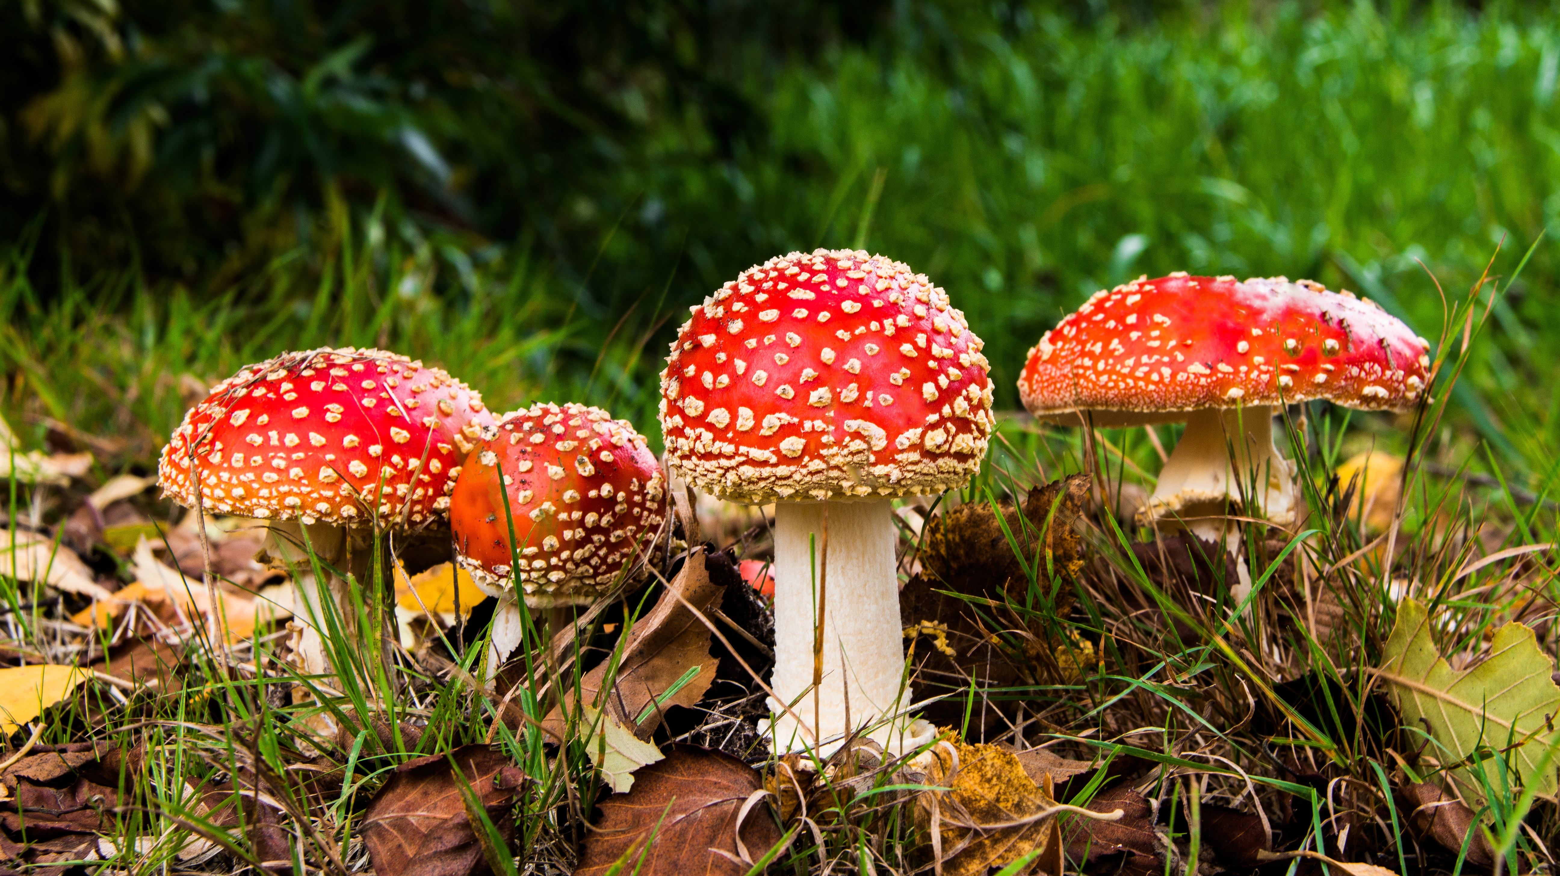
Mushroom Poisonousness Detection
MSCA 31009-2 Machine Learning & Predictive Analysis (Spring 2022)
Team 7: Yifan Jiang, Chang Gao, Amy Zhang, Jason Lee

Slide 2
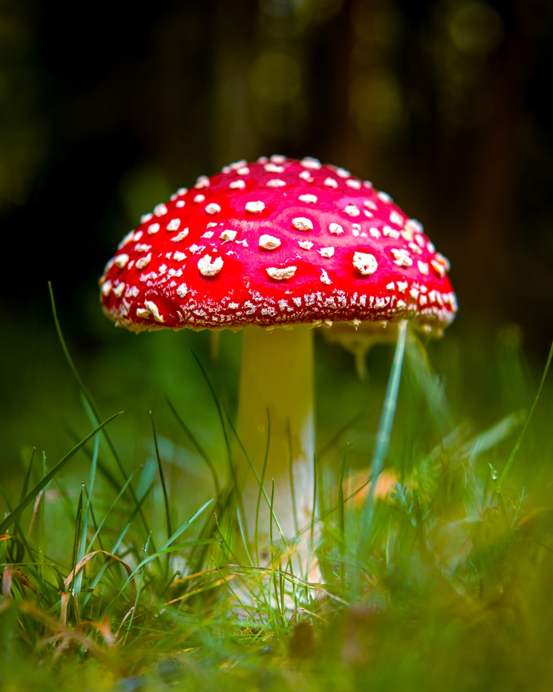
Table of Contents
Problem Statement
Data Description
EDA
Methodology and Tools
Modeling
Base Model
Model after Feature Engineering
Model after Feature Engineering + Dimension Reduction
Neural Network
Conclusion and Findings

Slide 3
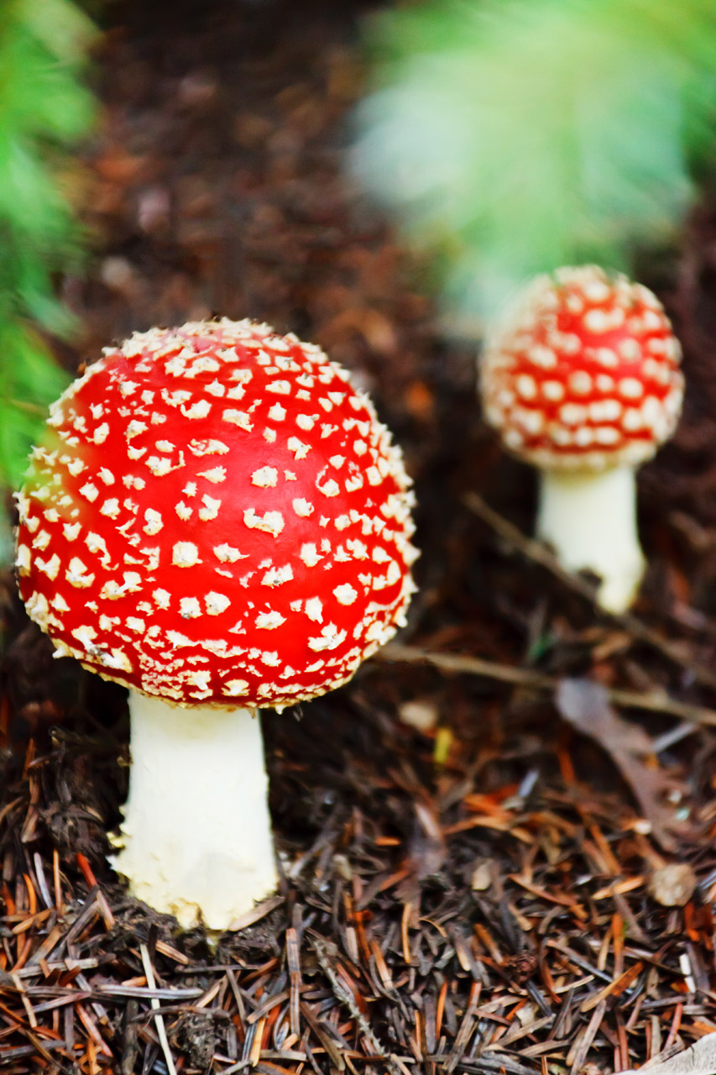
Problem Statement
Mushroom poison is among the leading food poisoning problems in countries like France and China. In France alone, there are over 10k mushroom poisoning cases over the past 10 years.¹ This calls for a model that helps identify poisonous mushrooms among the 10k types of mushrooms. The aim of this project is to build such a model that predicts the class (poisonous or edible) of a mushroom given various variables.
1. https://www.foodsafetynews.com/2019/12/thousands-poisoned-by-mushrooms-in-france-in-recent-years/

Slide 4


Variables | Description
class | Poisonous or edible
cap-shape, surface, color (3 columns) | Categorical/Binary variables that describe the shape, touch, and color of the mushroom’s cap
bruises | Binary variable (t/f) that indicate the presence of bruises
odor | Categorical variable describe the smell
gill-attachment, spacing, size, color (4 columns) | Categorical/Binary variable that describes the shape, size, and color of the mushroom’s gills
stalk-shape, root, surface-above-ring, surface-below-ring, color-above-ring, color-below-ring (7 columns) | Categorical/Binary variable that describes the shape, size, and color of the mushroom’s stalk
Veil-type, color (2 columns) | Categorical variables of the type and color of veil
Ring-number, type (2 columns) | Categorical variables of the type and number of ring
spore-print-color | Categorical variable of the color of spore print
population | Categorical variable of the population of mushroom
habitat | Categorical variables of the habitat of mushroom
Data Description
Data Link: https://www.kaggle.com/datasets/uciml/mushroom-classification
Data shape: (8124, 23)
Data size: 374 KB
Data type: String
Variable type: 23 Categorical

Slide 5
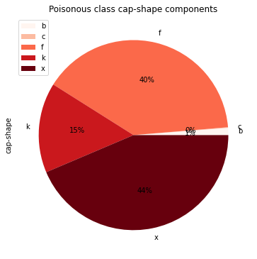
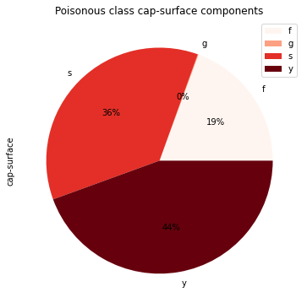
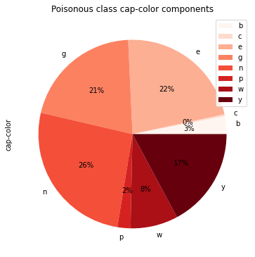
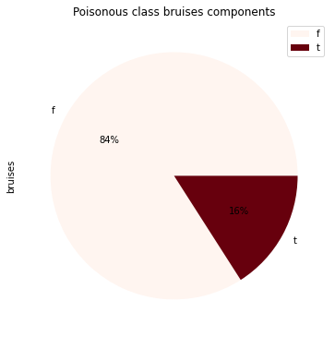
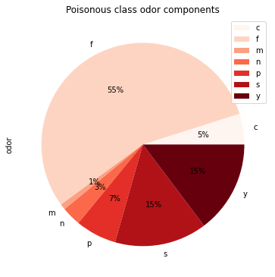
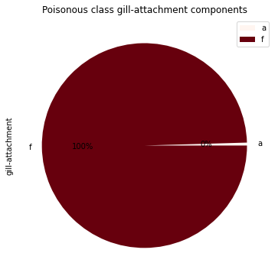
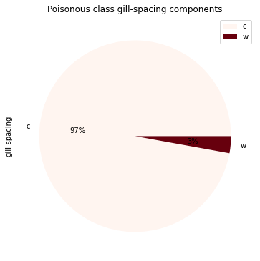

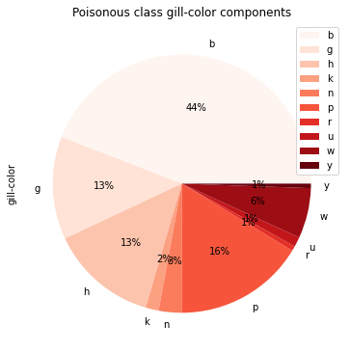
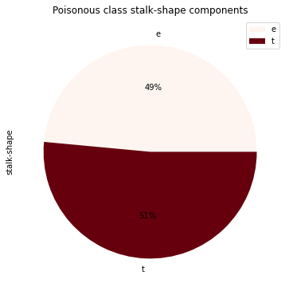

Exploratory Data Analysis
Cap Shape
Cap Surface
Cap Color
Bruises
Odor
Gill Attachment
Gill Spacing
Gill Size
Gill Color
Stalk Shape
Note: The highlighted features will be engineered later

Slide 6
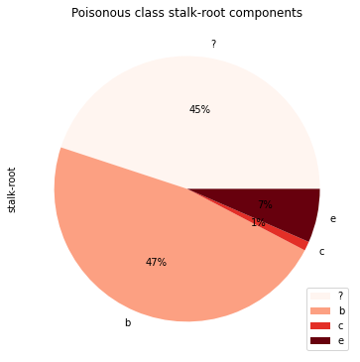
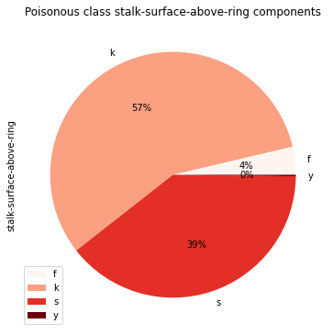
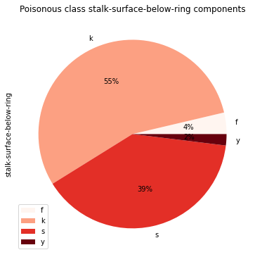
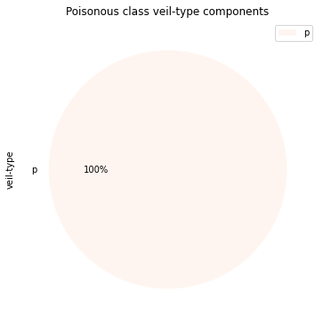
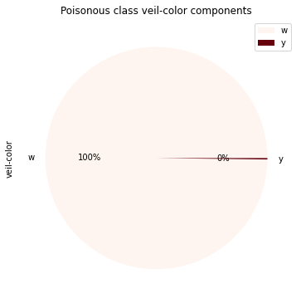
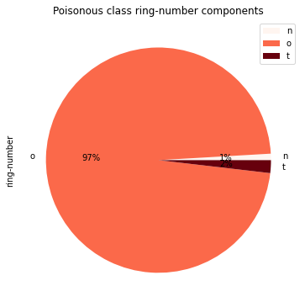
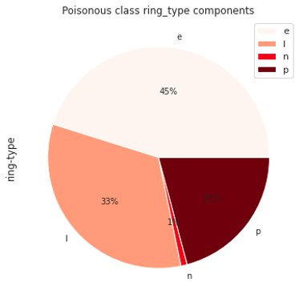
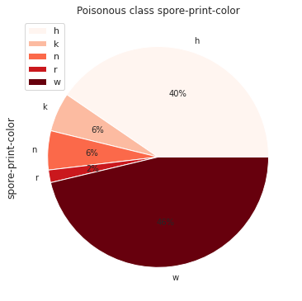
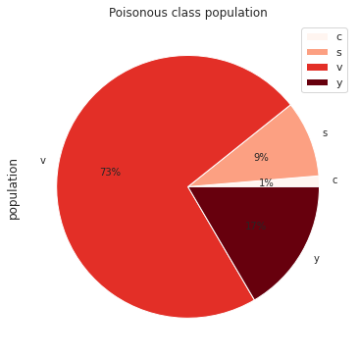
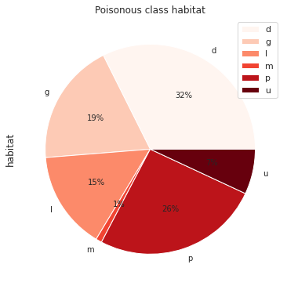
Exploratory Data Analysis
Stalk Root
Stalk Surface above Ring
Stalk Surface below Ring
Veil Type
Veil Color
Ring Number
Ring Type
Spore Print Color
Population
Habitat
Note: The highlighted features will be engineered later
Notes:
yifanj

Slide 7
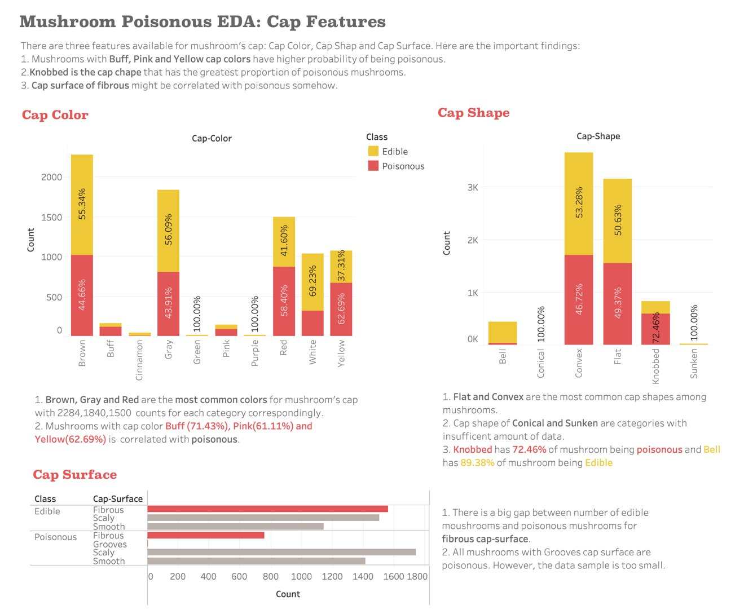
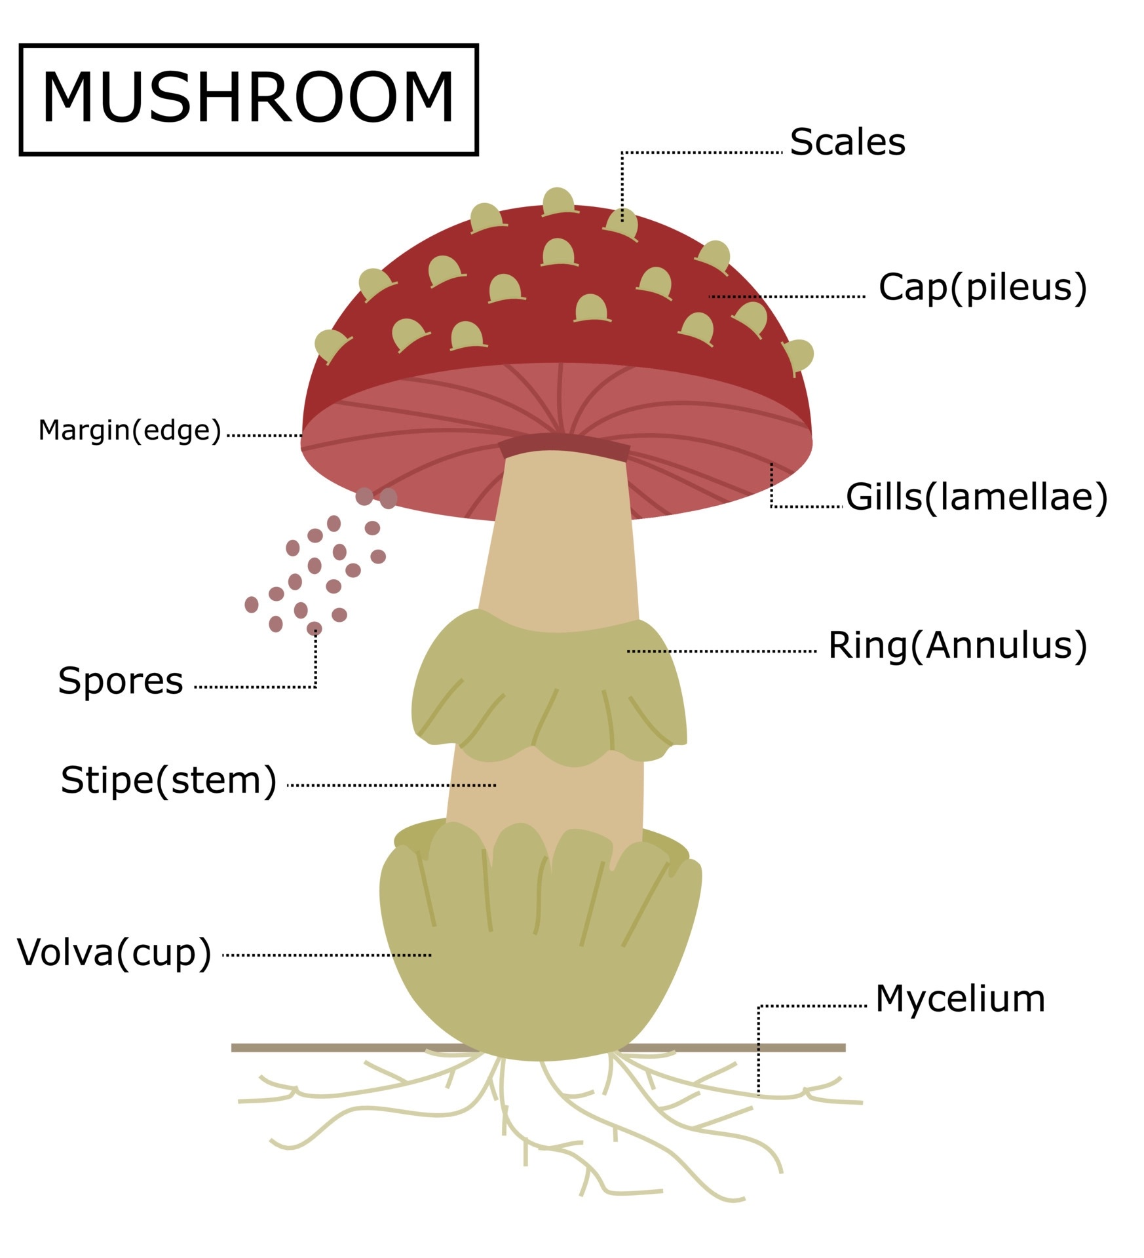

Cap Features

Slide 8
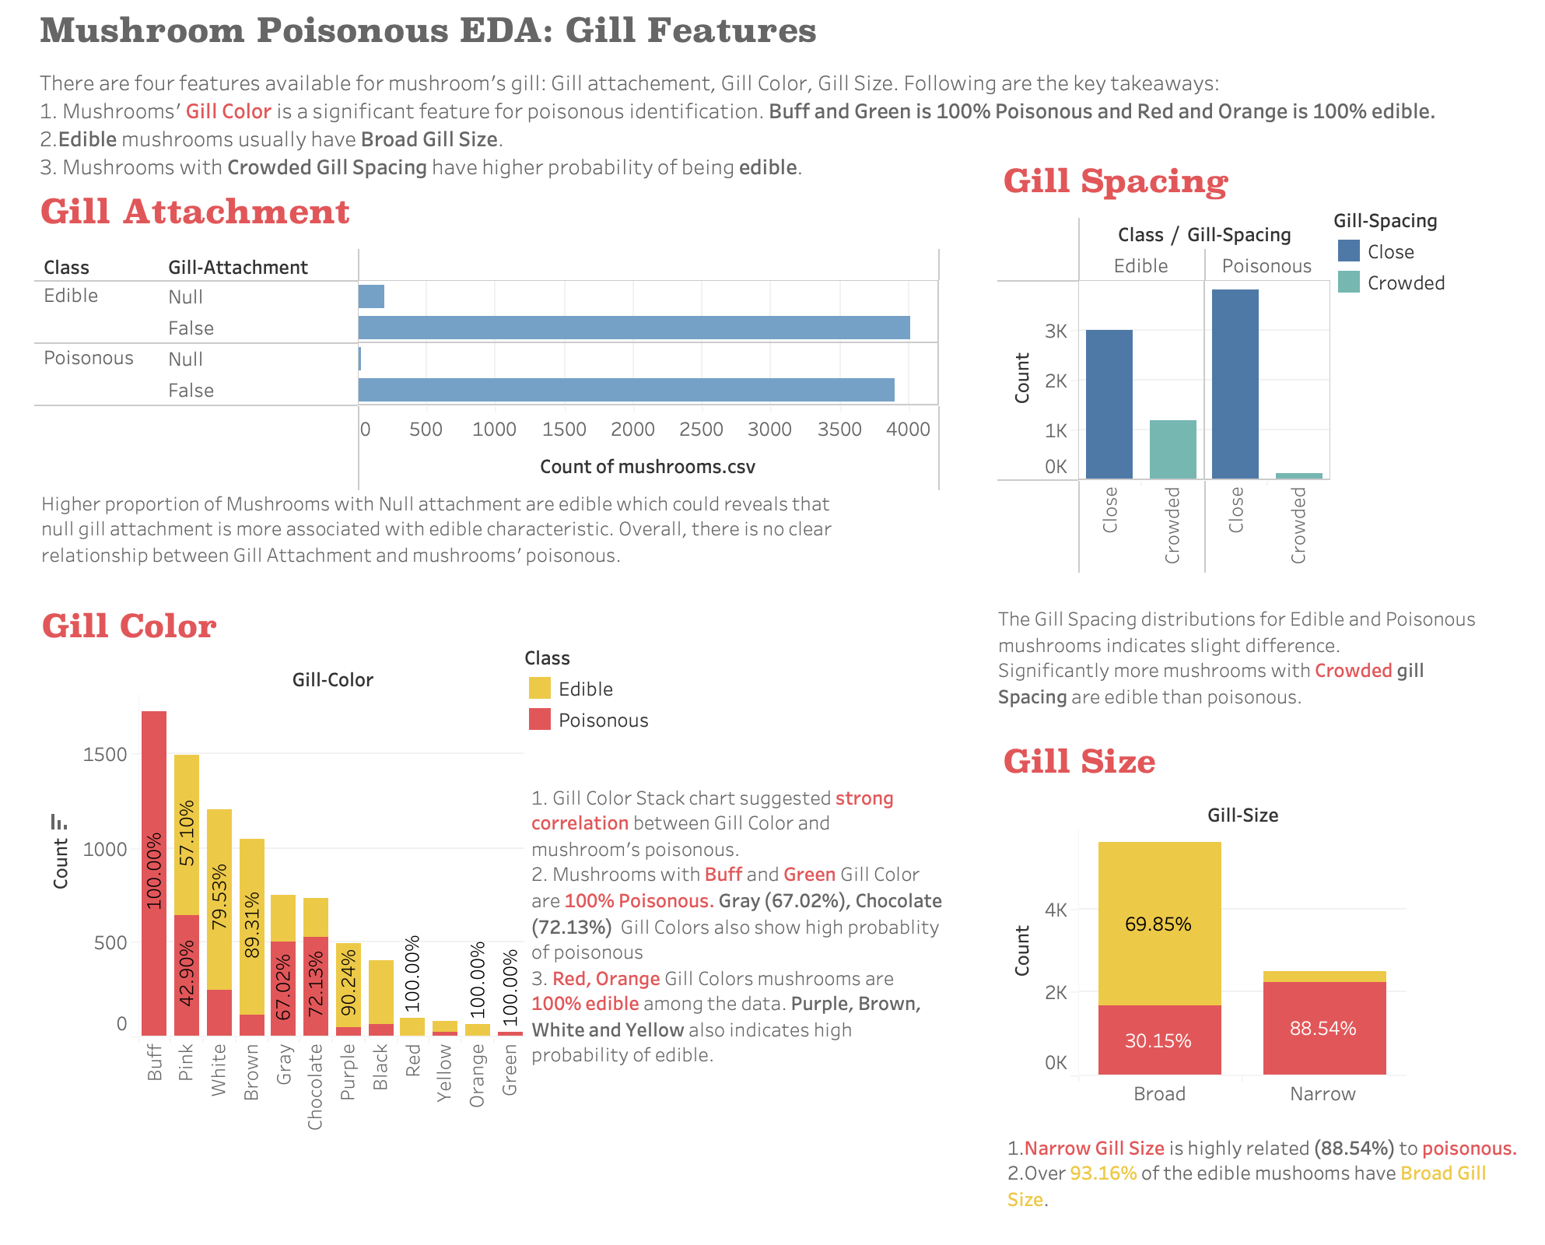
Gill Features

Slide 9
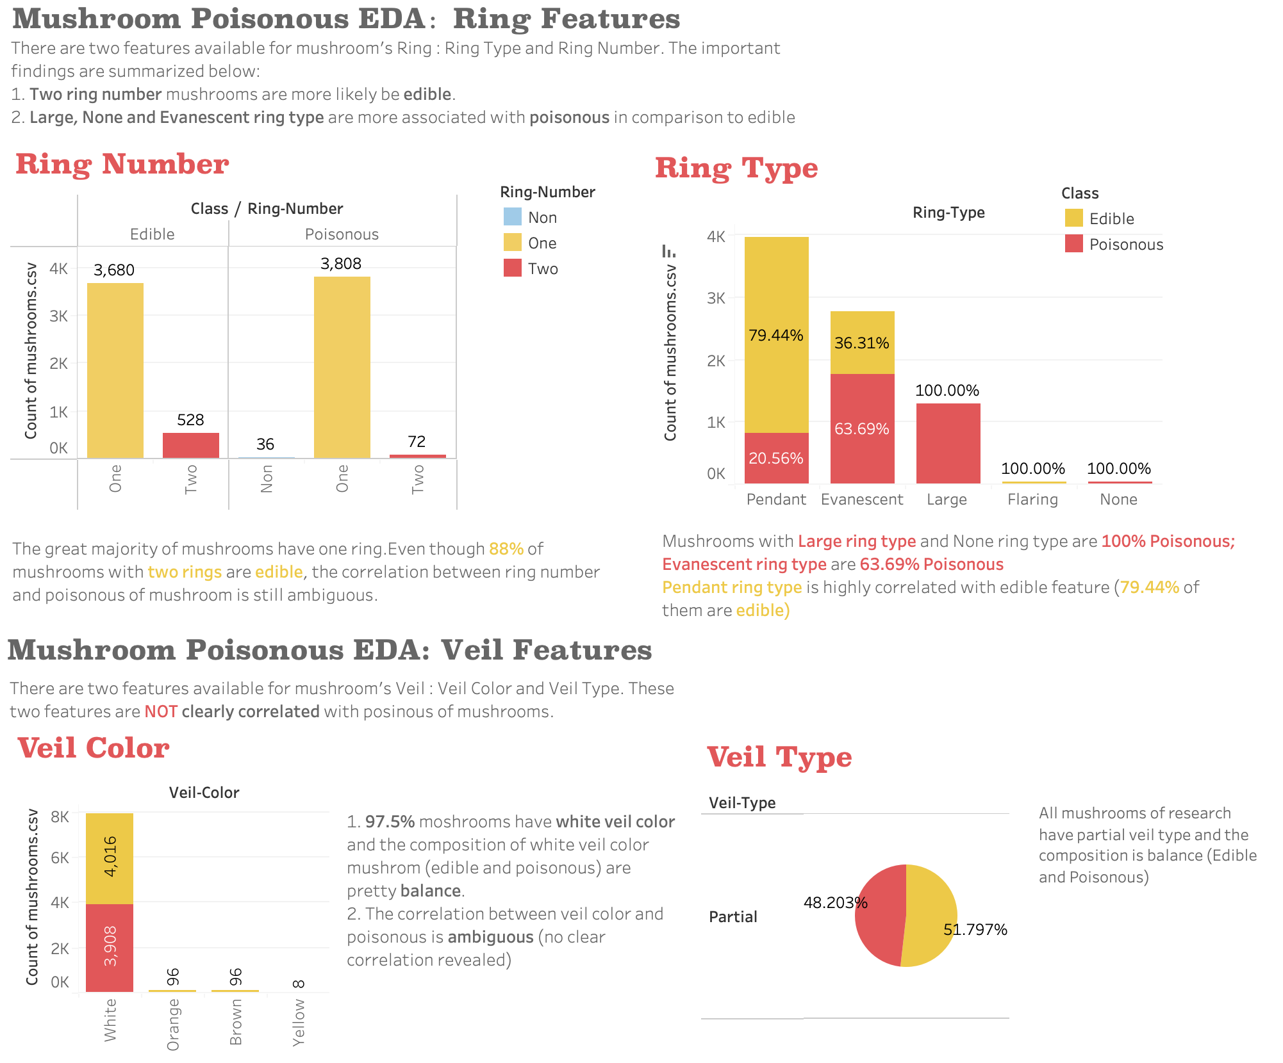
Ring and Veil Features

Slide 10
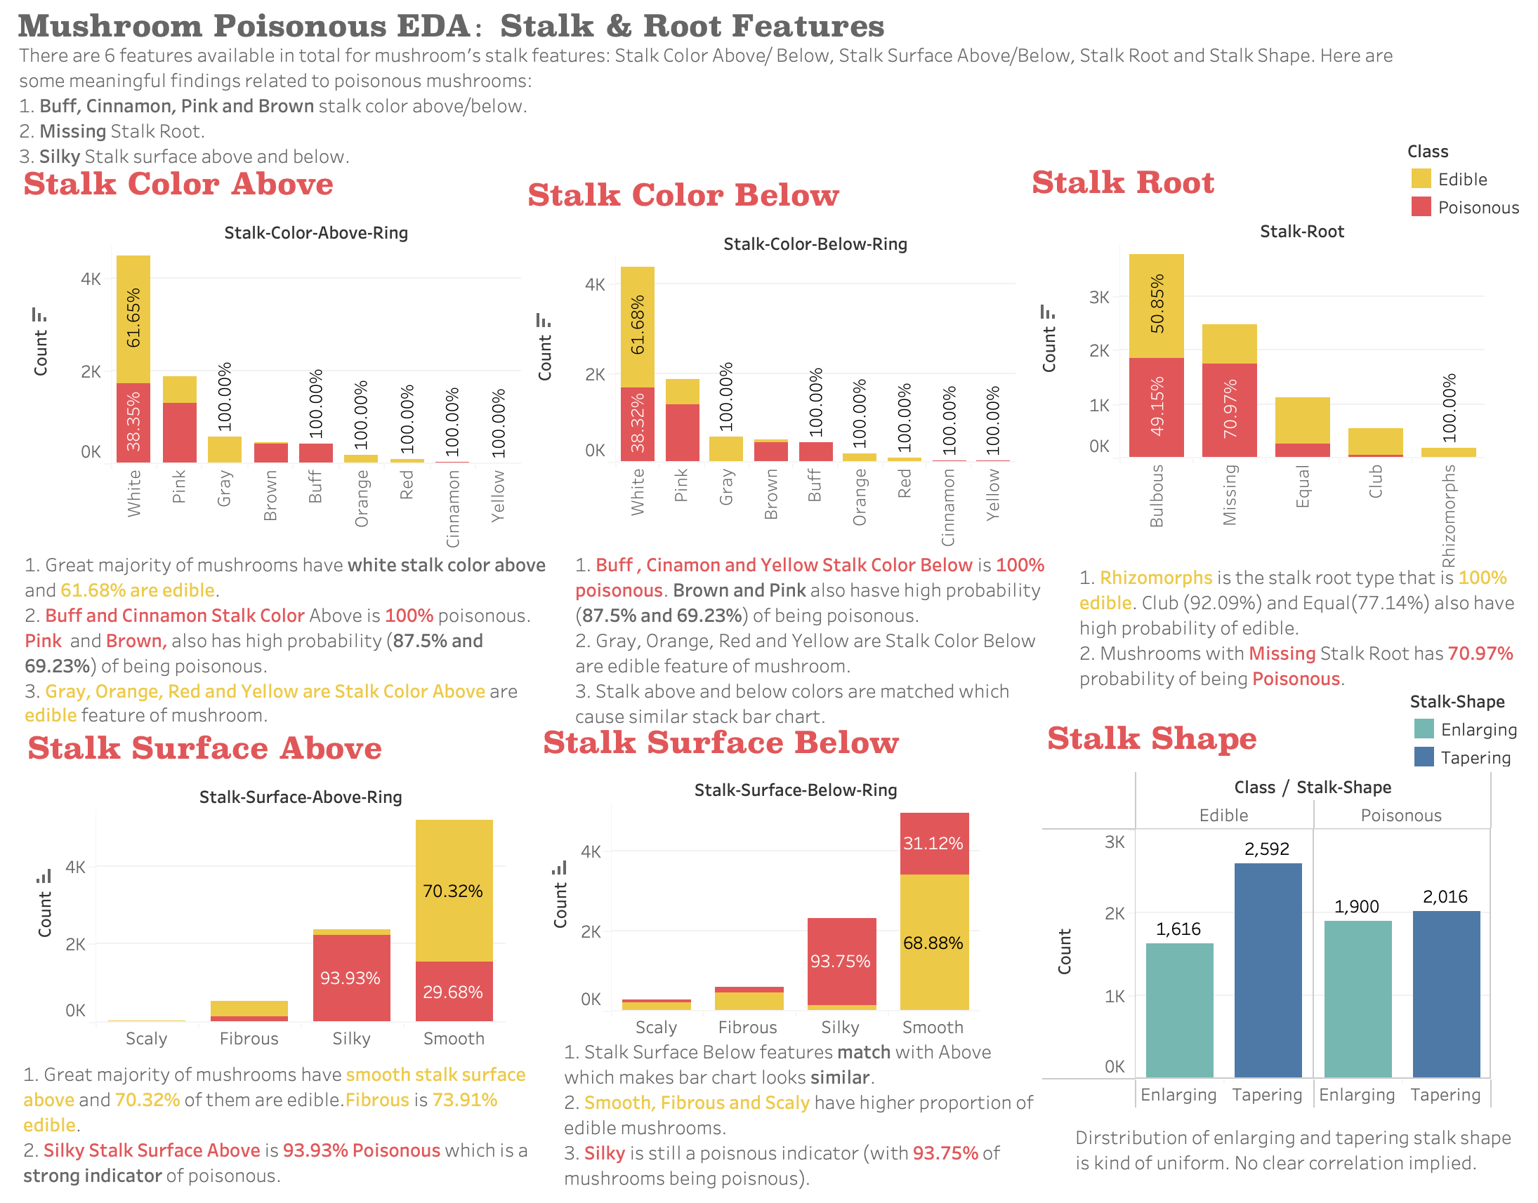



Stack Features

Slide 11
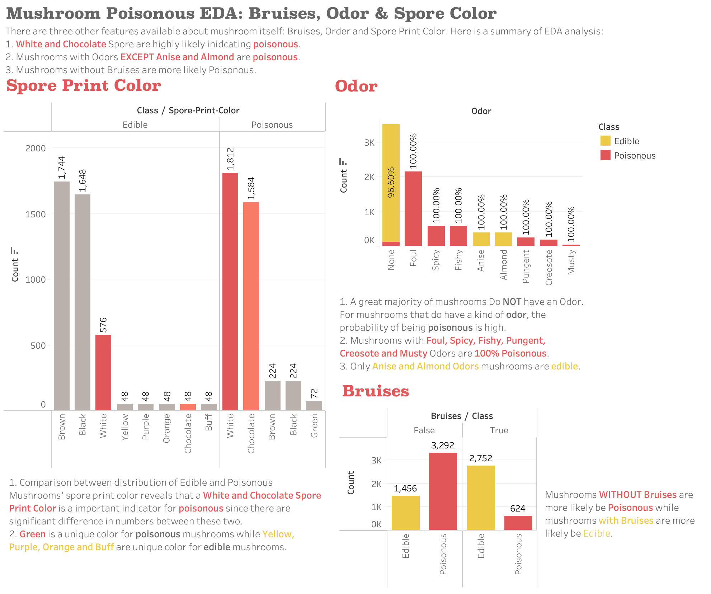

Bruises, Odor
& Spore Color

Slide 12
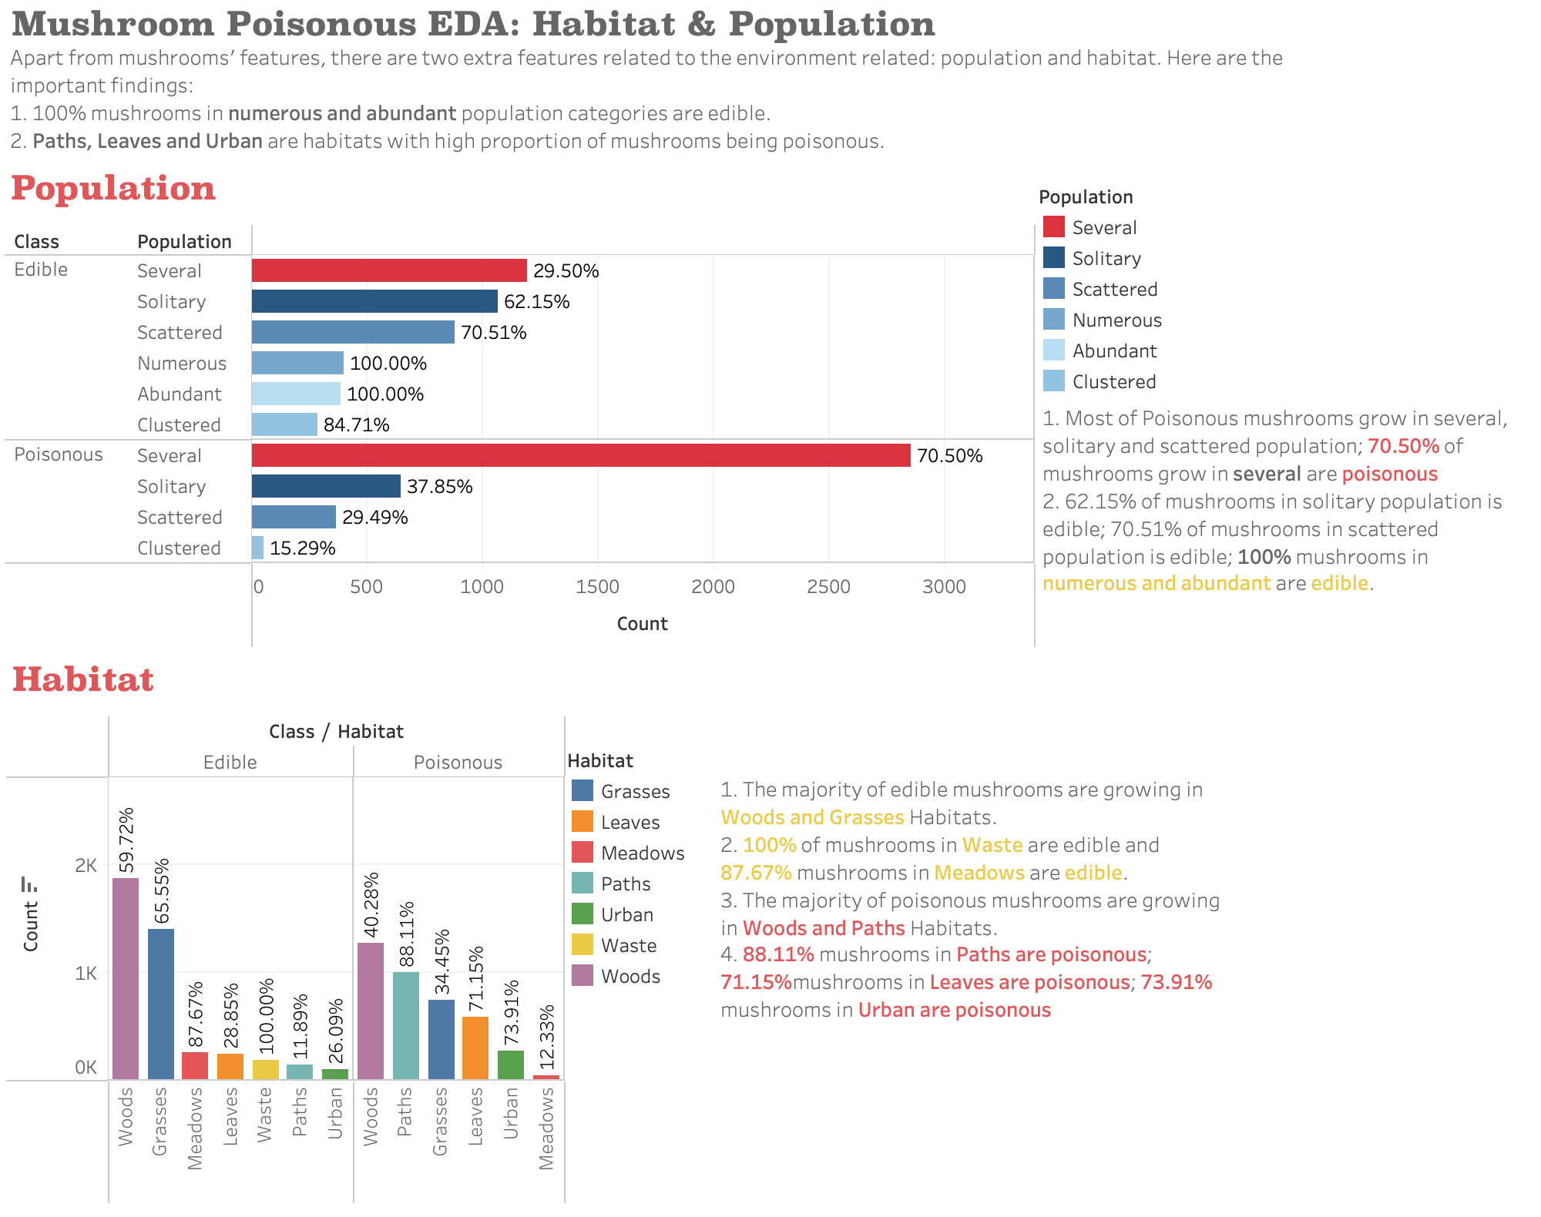
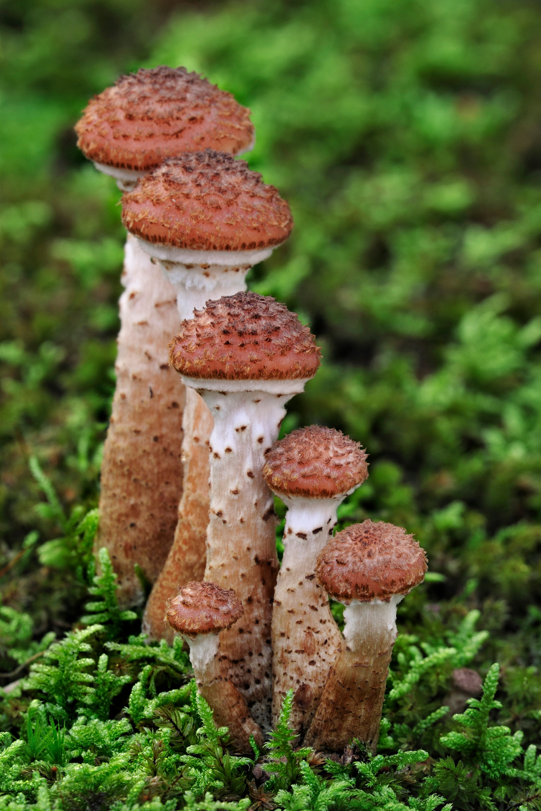
External Features

Slide 13


Methodology
Dimensional Reduction
MCA
PCA
Traditional Supervised ML model
Logistic Regression
Traditional Unsupervised Learning
SGD Classifier
K-Modes (Clustering)
Deep Learning
Support Vector Classification
Neural Network
Google Collaboratory
Data Storage
Google Drive
Cloud Platform
Random Forest
Decision Tree

Slide 14
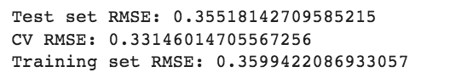
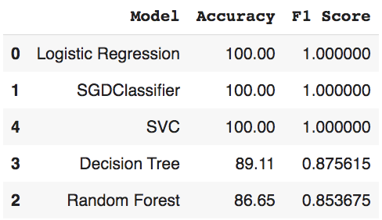
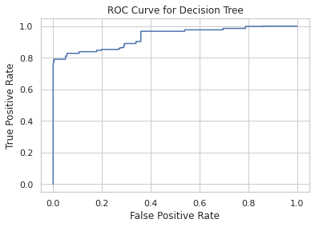
Base Models
Base models performance without Feature Selection or dimension reduction
Overfitting Problem
Findings
The first 3 algorithm don't differentiate much since the accuracy & F1 score = 1
After evaluating the train/test RMSE for Random Forest, we found that there's overfitting problem existed.
So, we decided to do feature engineering and dimensional reduction

Slide 15
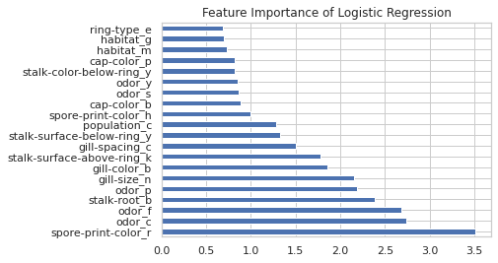
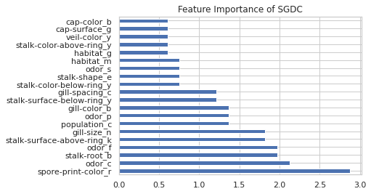
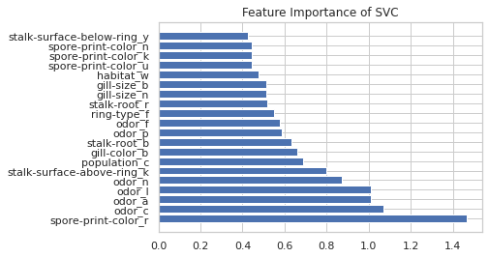
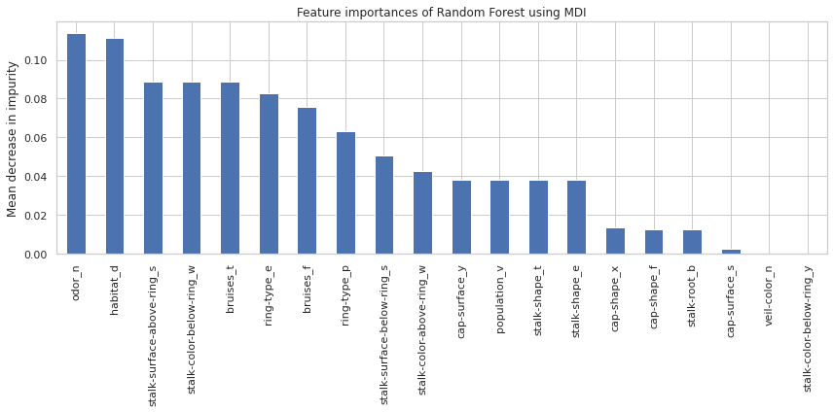
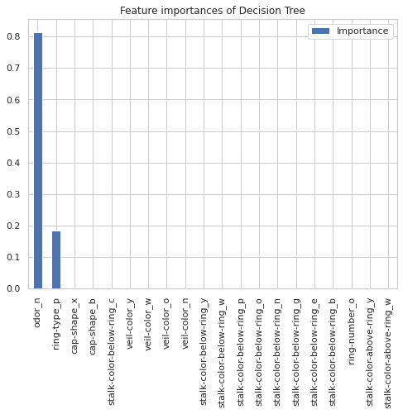
Feature Importance - Base Model
Findings
For each of the algorithms, there are always 2+ features that make up most of the feature importance, and that could lead to overfitting problem
For example, odor_c (odor = none) and spore-print-color_r (= green) take the top 2 importance for all the logistic regression, SGDC, and SVC.
For Random Forest, ordor_n, habitat_d (=woods) are the top 2 important features. Decision tree sorely depends on 2 features, ordor_n and ring_type_p (=pendant), which might be a cause of the overfitting.
Logistic Regression
SGDC
SVC
Random Forest
Decision Tree

Slide 16
Feature Engineering
To avoid overfitting, classes with <5% samples are consolidated judgmentally
Example: Cap Shape
Class | Weight
Convex | 45.00%
Flat | 38.80%
Knobbed | 10.19%
Bell | 5.56%
Sunken | 0.39%
Conical | 0.05%
Class | Weight
Convex | 45.00%
Flat | 38.80%
Knobbed | 10.19%
Others | 6.01%
Consolidation

Slide 17
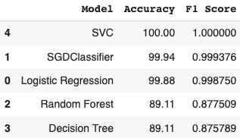
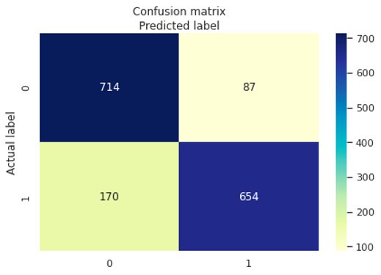
Feature Engineering
Feature Engineering : 14 features engineered
"Balanced" Accuracy
Findings
Model performance decreases for SGDClassifier, Logistic Regression
Model performance stays the same for SVC at F1 = 1
Model performance improves for Random Forest and Decision Tree
Random Forest

Slide 18
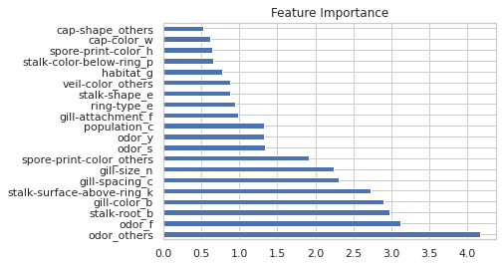
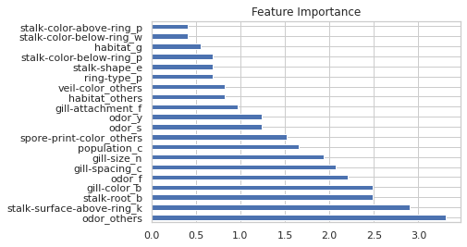
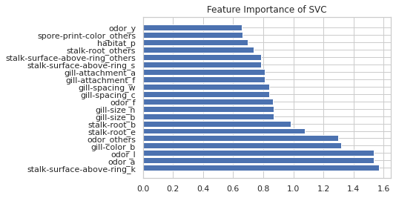
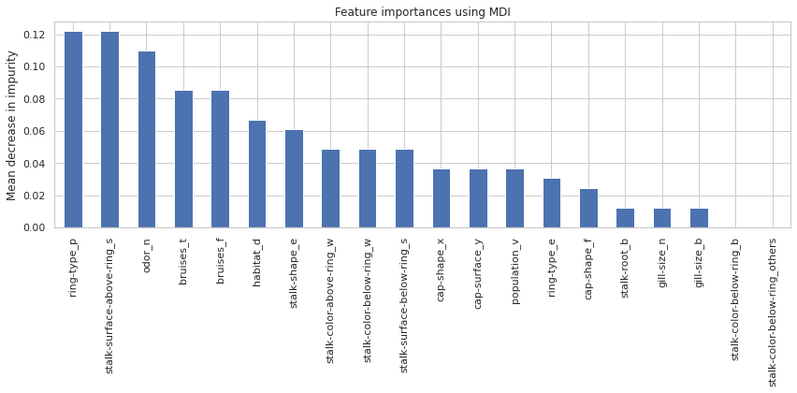
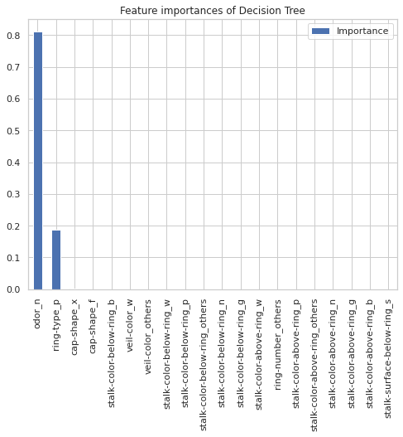
Feature Importance after Feature Engineering
Findings
Diversified features that take the top 5 features importance for algorithm Logistic Regression, SGDC, and SVC instead of just two before feature engineering.
For Random Forest, the features that take the top 2 importance have been diversified to stalk-surface-above_s (=smooth) and odor_p (=pungent). For decision tree, it remained unchanged since there're always 2 features take the importance
Logistic Regression
SGDC
SVC
Random Forest
Decision Tree

Slide 19
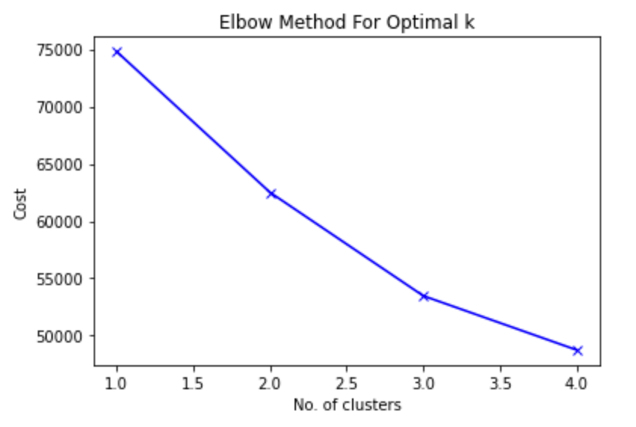
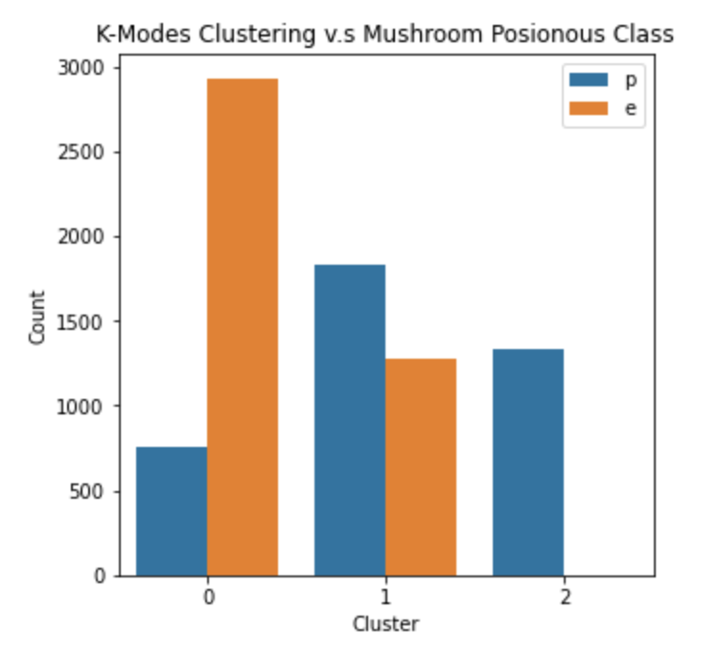
K-Modes Clustering
Since our objective is to classify mushrooms into two categories: Edible or Poisonous, appropriate clustering method provide a non-supervised machine learning approach to group the data.
With all variables being categorical, K-Modes clustering is a good fit for our case.
# of Clusters Selection
Clustering Result
Applied Elbow Method to determine the number of clusters
K = 3 is selected
All mushrooms in cluster 2 are poisonous while edible and poisonous are mixed in cluster 0 and 1.
Clustering FAILED to distinguish poisonous mushrooms from edible. Supervised machine learning approach should be introduced.

Slide 20
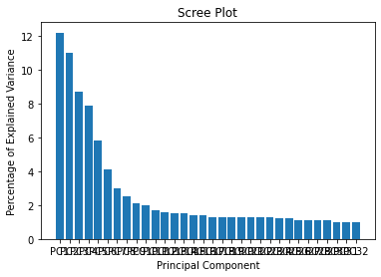
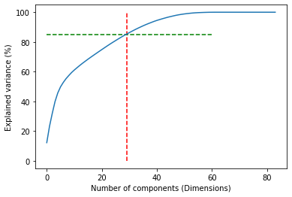
Dimensional Reduction - PCA
PCA
PCA is able to transfer all correlated features into all non-correlated features
29 components could explain at least 85% variance
PCA Bar Plot
Screen Line Plot - 85% variance

Slide 21
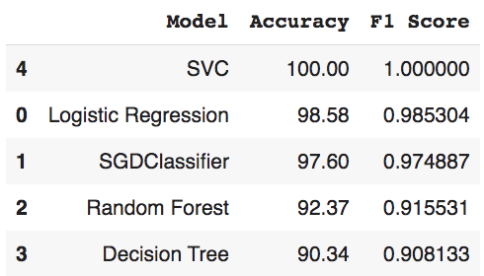

Model – Feature Engineering & PCA
PCA: 29 components explain 85% variance
"Balanced" Accuracy
Findings
Decreased accuracy for Logistic Regression and SGD from overly high, but still among the highest accuracy
SVC’s accuracy still maintain very high (= 100.00), thus doesn’t give much information about the features of the model performance.
Accuracy for random forest and decision tree has been greatly increased from ~80% to ~90%
Random Forest

Slide 22


Dimensional Reduction - MCA
MCA
Multiple Correspondence Analysis (MCA) reduces the categorical features by creating a matrix with values of zero or one
31 component could explain at least 85% variance
2D MCA Plot
Screen Line Plot - 85% variance

Slide 23


Model – Feature Engineering & MCA
MCA: 31 components explain > 85% variance
"Balanced" Accuracy
Findings
Decreased accuracy for Logistic Regression, SVC, and SGDC from overly high, but still fairly high (~ 99%)
Accuracy for Random Forest and Decision Tree has been greatly increased from ~80% to ~90%
Random Forest

Slide 24


Model Comparison
Base
Feature Engineering
Feature Engineering + PCA: log_reg
Feature Engineering + PCA
Feature Engineering + MCA
Feature Engineering + MCA: log_reg
MCA wins in terms of false negative rate!!

Slide 25



Model – Neural Network
3 Layer dense neural network
First 2 Layers: Relu activation
Final Layer: Sigmoid activation
Optimizer: Root Mean Squared Propagation
Loss Function: Binary cross entropy
Neural Network seemed to be too complicated for this application, leading to potential over fitting.

Slide 26

Evaluation Metrics
Cost of False Positives
Cost of False Negatives
An edible mushroom is falsely predicted as poisonous
If there is the last mushroom left in the world, people would starve to death (but there are still plenty of edible mushrooms)
A poisonous mushroom is falsely predicted as edible
Sweating, salivation, hallucinations, flushed skin, dilated pupils, delirium, and drowsiness
Or even worse, death
<
Therefore, our goal is to maximize recall
Notes:
To decide which evaluation metric to use on our model, we need to understand the cost difference in a false negative prediction and a false positive prediction.

Slide 27
Model Selection
Model | Accuracy | Recall | Precision | F1
Baseline Models
Logistic Regression | 1.00 | 1.00 | 1.00 | 1.00
SGDClassifier | 1.00 | 1.00 | 1.00 | 1.00
SVC | 1.00 | 1.00 | 1.00 | 1.00
Decision Tree | 0.90 | 0.79 | 1.00 | 0.88
Random Forest | 0.88 | 0.79 | 0.93 | 0.86
Feature Engineered Models
Logistic Regression | 1.00 | 1.00 | 1.00 | 1.00
SGDClassifier | 1.00 | 1.00 | 1.00 | 1.00
SVC | 1.00 | 1.00 | 1.00 | 1.00
Decision Tree | 0.89 | 0.78 | 1.00 | 0.87
Random Forest | 0.84 | 0.79 | 0.88 | 0.83
Feature Engineered + PCA/MCA Models
Logistic Regression | 0.99/0.99 | 0.99/0.98 | 0.99/0.98 | 0.99/0.98
SGDClassifier | 0.98/0.99 | 0.97/0.99 | 0.99/0.98 | 0.98/0.99
SVC | 1.00/0.99 | 1.00/0.99 | 1.00/0.98 | 1.00/0.98
Decision Tree | 0.90/0.92 | 0.99/0.99 | 0.87/0.87 | 0.93/0.93
Random Forest | 0.92/0.90 | 0.83/0.86 | 0.98/0.96 | 0.90/0.90
Neural Network Model
Neural Network | 1.00 | 1.00 | 1.00 | 1.00

Slide 28

Evaluation after Model Selection
Given our goal of maximizing recall, we decide to recommend SVC because it returns the highest (100%) recall after feature engineering. It’s performance after PCA and MCA is also stable compared to other models
SVC works relatively well when there is a clear margin of separation between classes. And since in our case, all the variables are categorical, we DO have clear margin between classes, and that is why SVC has good performance and why we choose SVC over others.

Slide 29

Findings and Conclusions
Odor is the most important feature. While in the wild, you'll have a better chance picking an edible mushroom if it doesn’t have any odor
Neural Network seems to be too complicated in this application
Feature importance ranking for different models is more diverse after feature engineering. We start to see differences in the ranking from different models
Dimensional reduction helps to resolve the highly correlated variables in selective cases. For decision tree and random forest, model performance is improved after dimensional reduction

Slide 30
Reference
Chaikitwattana, wanpiya. “Structure of a Amanita Mushroom.anatomy of the Fungus.vector Illustration.infographic for Design.” Vecteezy. vecteezy, March 1, 2022. https://www.vecteezy.com/vector-art/6171228-structure-of-a-amanita-mushroom-anatomy-of-the-fungus-vector-illustration-infographic-for-design.
Google search. Google. Accessed May 29, 2022. https://www.google.com/search?q=environment%2Bmushroom&tbm=isch&ved=2ahUKEwjetLH23_v3AhUzgHIEHUDKBQQQ2-cCegQIABAA&oq=environment%2Bmushroom&gs_lcp=CgNpbWcQAzIGCAAQHhAIMgYIABAeEAgyBggAEB4QCDoICAAQgAQQsQM6BQgAEIAEOgYIABAeEAVQ7QRYiBtg8BxoAHAAeACAAViIAbMHkgECMTOYAQCgAQGqAQtnd3Mtd2l6LWltZ8ABAQ&sclient=img&ei=T7SOYp7RB7OAytMPwJSXIA&bih=701&biw=1440&rlz=1C5CHFA_enUS895US895#imgrc=ziGwvntEmQ6d1M.
Dan, DanDan 44.2k1616 gold badges8181 silver badges148148 bronze badges, AxoisAxois 1, and Jan TrienesJan Trienes 2. “Using MCA Package in Python.” Stack Overflow, September 1, 1965. https://stackoverflow.com/questions/48521740/using-mca-package-in-python.
Hester, Jessica Leigh. “Get to Know New Zealand's Hugely Popular, Thrillingly Blue Mushroom.” Atlas Obscura. Atlas Obscura, November 1, 2021. https://www.atlasobscura.com/articles/blue-mushroom-new-zealand.
Harika Bonthu."KModes Clustering for Categorical Data", June 13,2021. https://www.analyticsvidhya.com/blog/2021/06/kmodes-clustering-algorithm-for-categorical-data/

